Slide 1

Spring into AI
Building intelligent applications with Spring AI
Dan Vega - Spring Developer Advocate @Broadcom

Slide 2


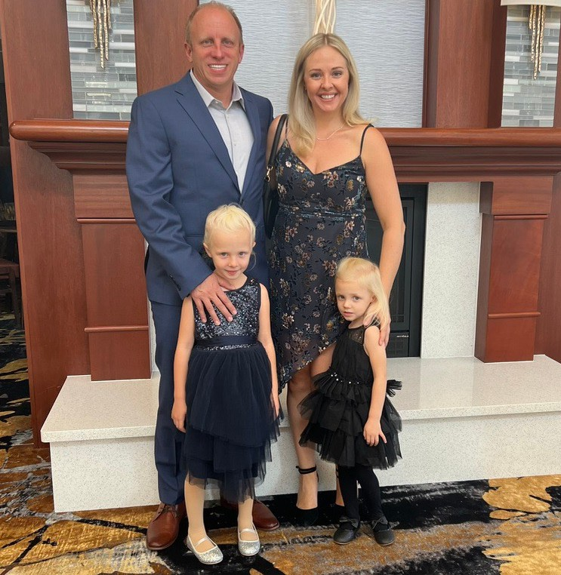





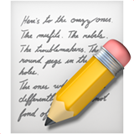



About Me
Learn more at danvega.dev
Husband & Father Cleveland
Java Champion
Software Development 23 Years Spring Developer Advocate Content Creator @therealdanvega
Running Golf

Slide 3
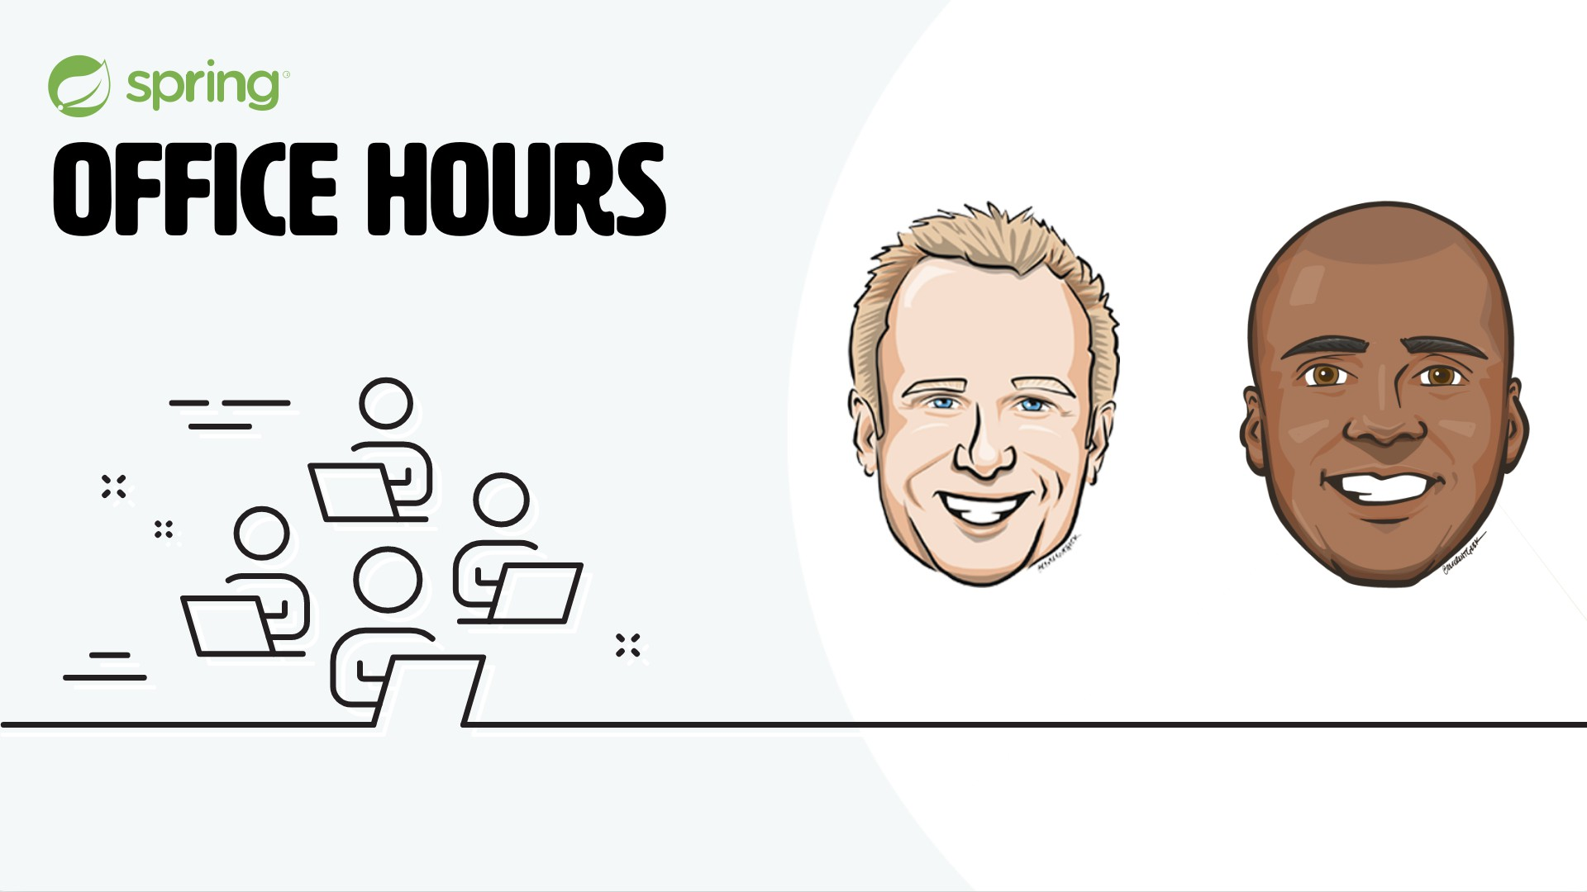
https://www.springofficehours.io

Slide 4
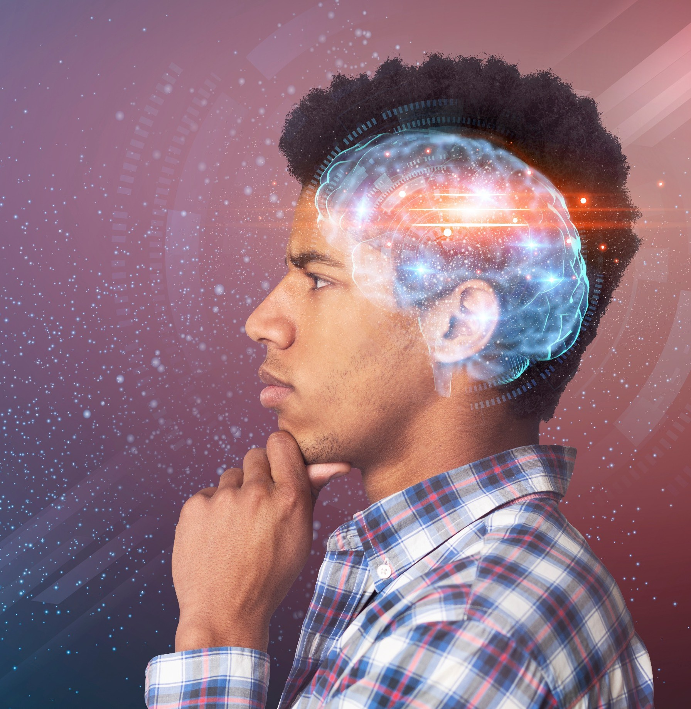
Agenda
What we will cover today
What is AI?
Java & AI Spring AI
How to get started
Models
Prompts
Output Parsers
Bring your own data

Slide 5


What is Artificial Intelligence (AI)?

Slide 6
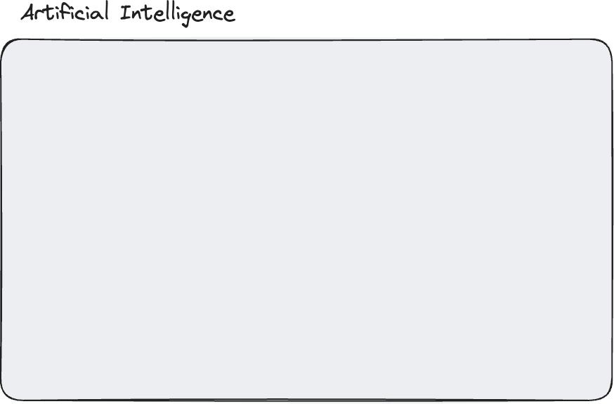
What is Artificial Intelligence

Slide 7
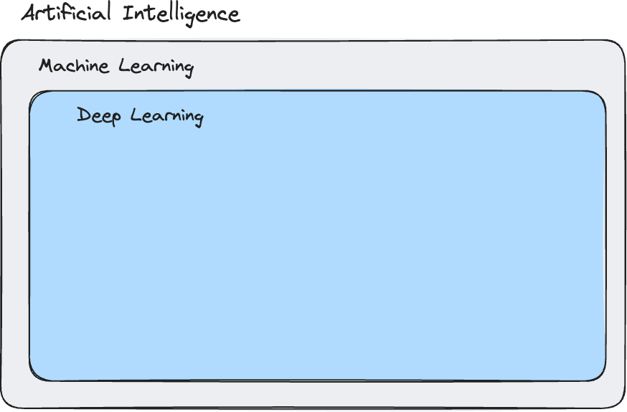
Machine learning

Slide 8
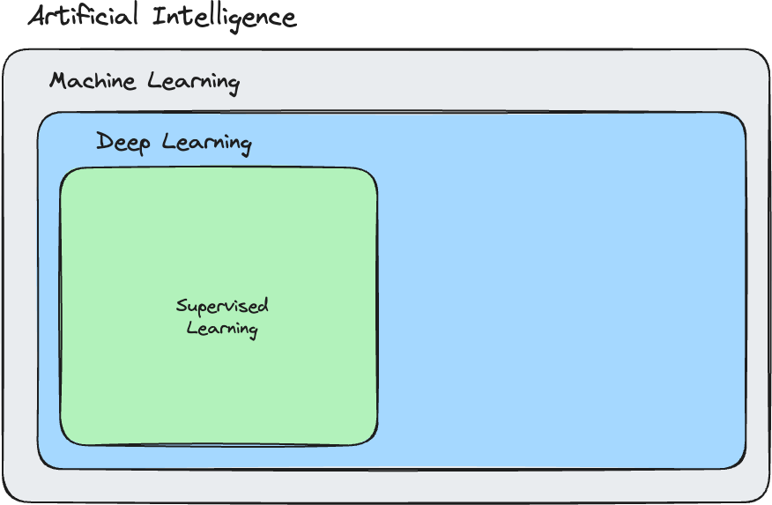
Machine learning
Supervised Learning

Slide 9
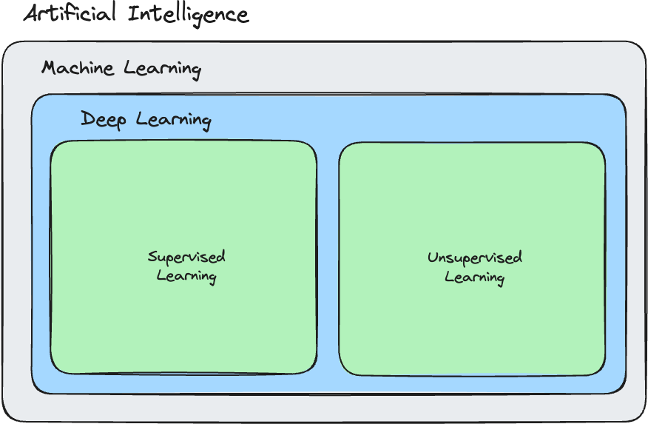
Machine learning
Unsupervised Learning

Slide 10
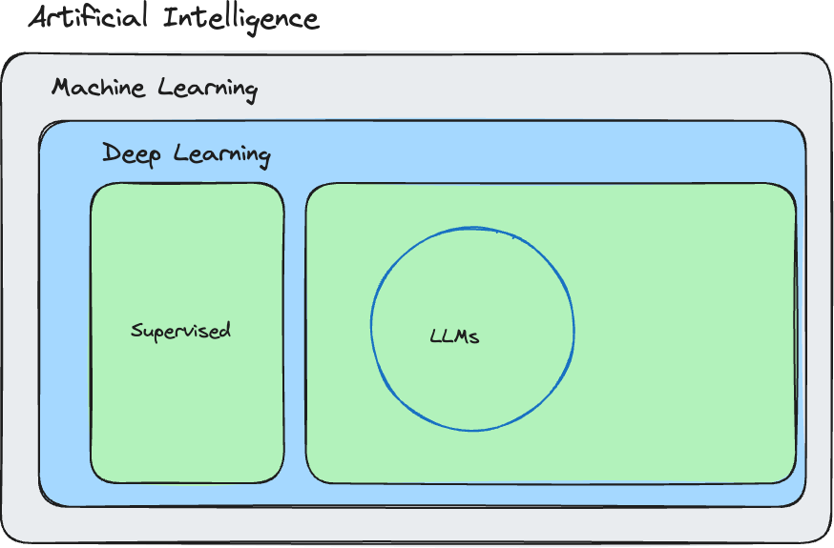
Large language models (llm)

Slide 11
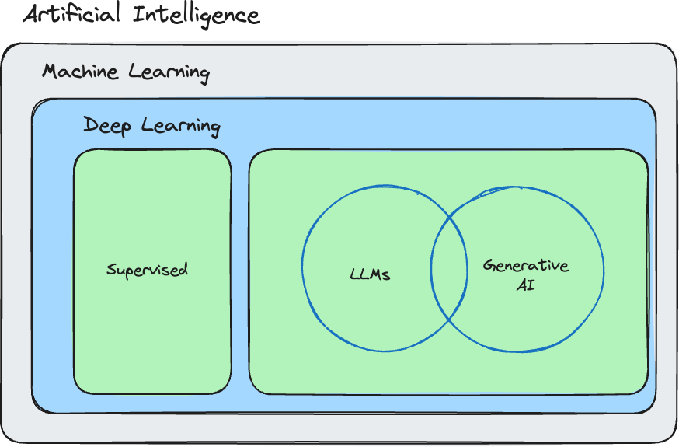
Generative AI

Slide 12
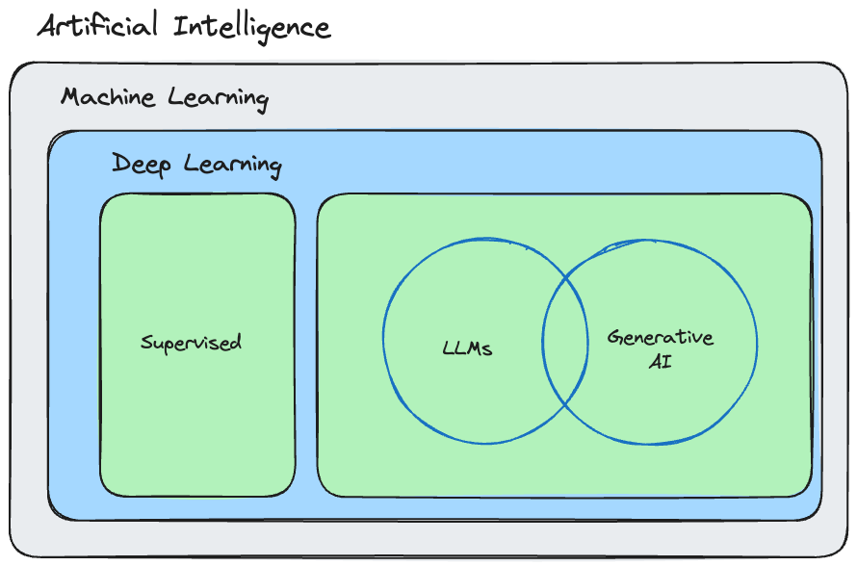


Generative AI

Slide 13

Machine learning

Slide 14
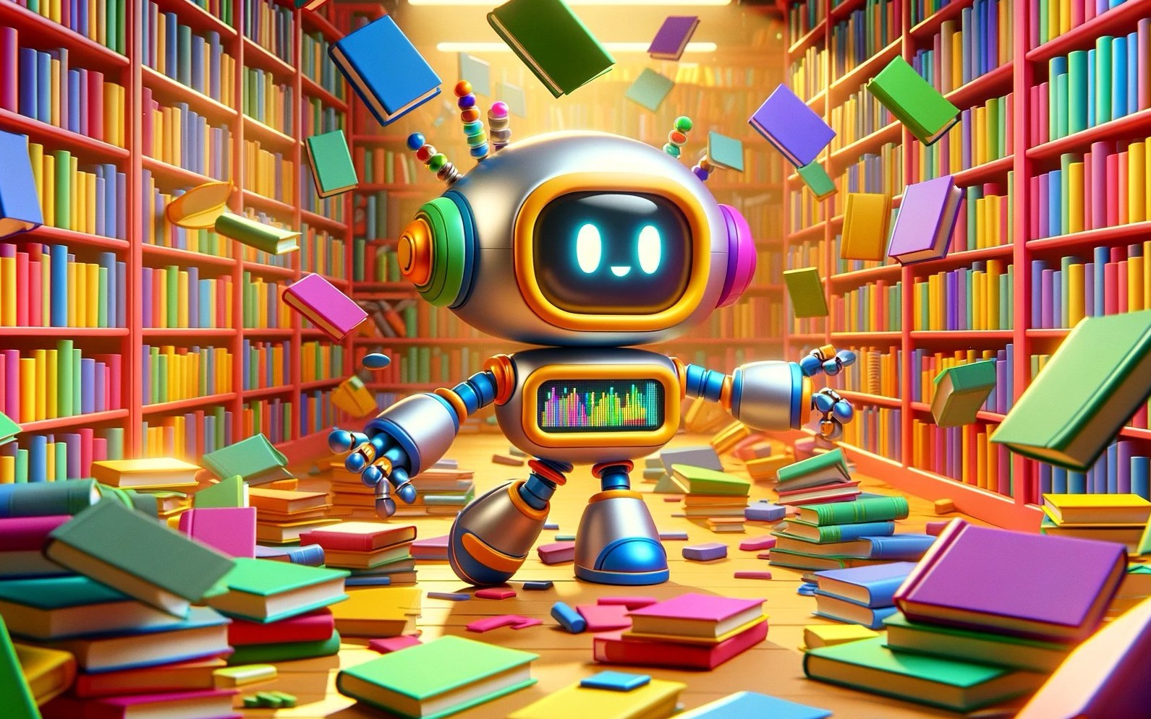

Slide 15
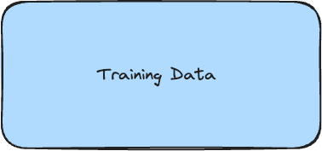
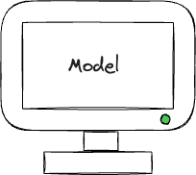
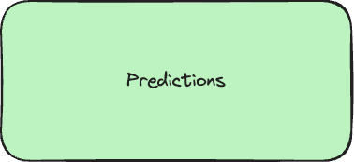
What is machine Learning?

Slide 16
Machine Learning
Use Cases
Facial Recognition
Recognize Tumors on x-ray scans
Abnormality on ultrasounds
Self-driving mode (recognize stop sign / pedestrian / etc)
Fraud detection
Product Recommendations (YouTube)
Spam Filtering

Slide 17


Slide 18
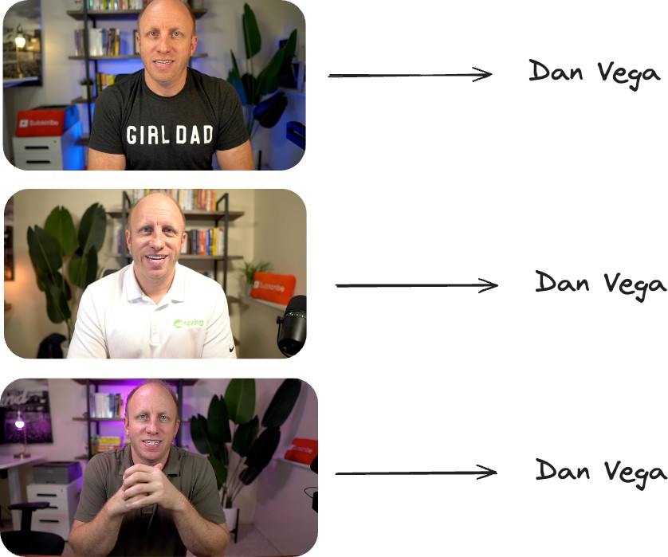
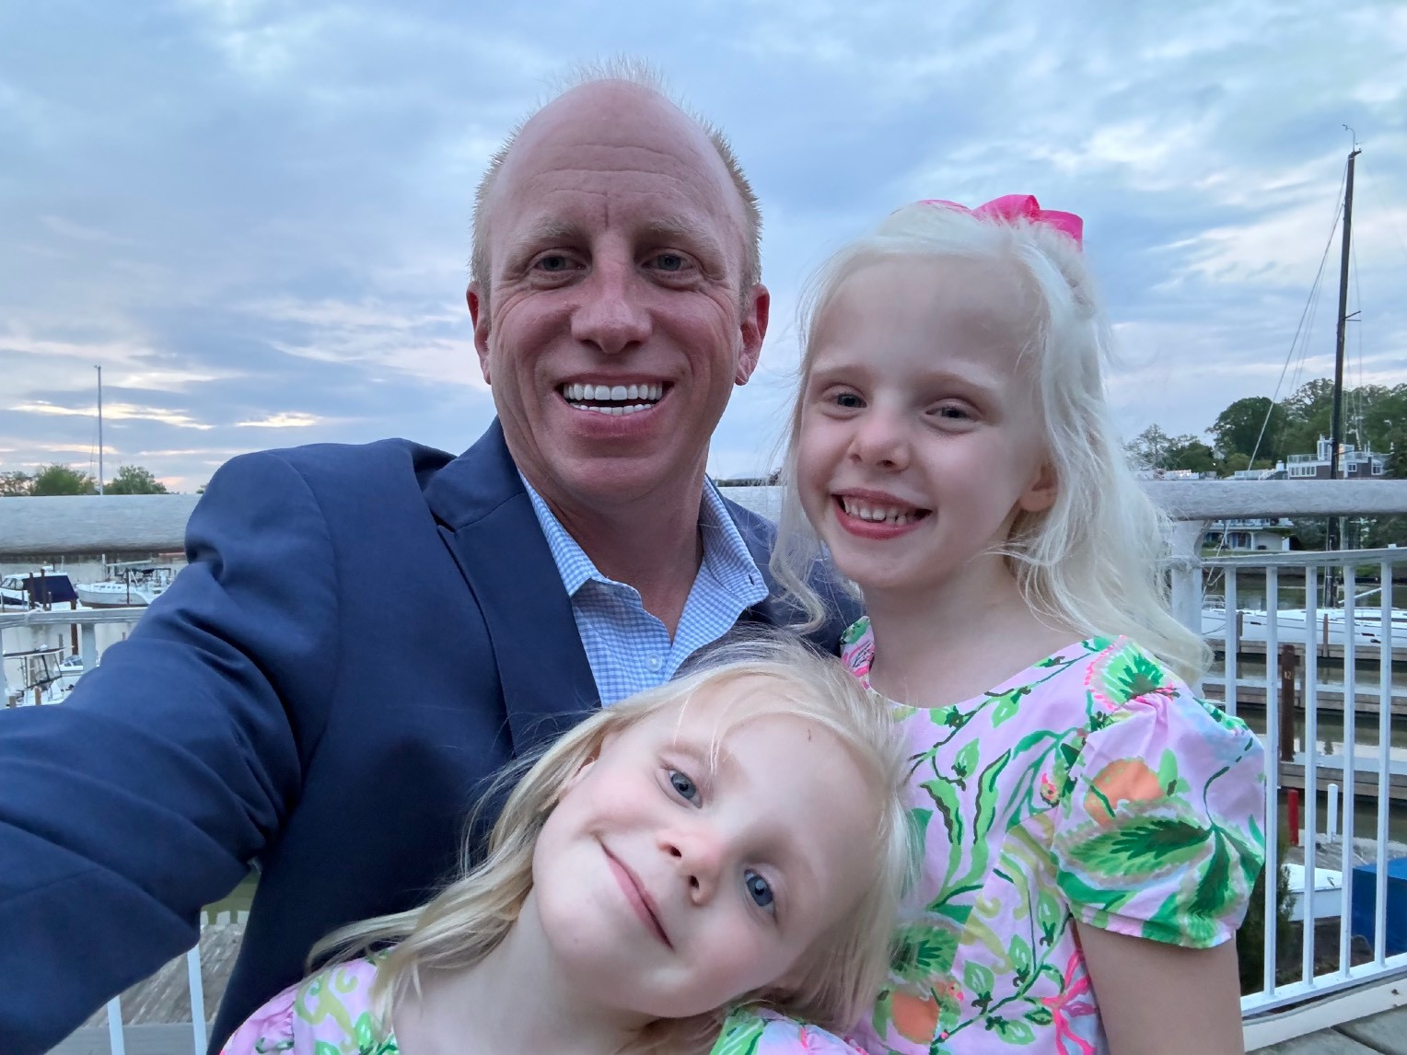
Supervised Learning
Labeling the training data

Slide 19



Training Data
Supervised Learning of Big Data Companies

Slide 20
How does machine learning work?

